Slide 1



Employee Data Analysis using Excel
STUDENT NAME:GOKUL.R
REGISTER NO:312207221
DEPARTMENT:B.COM(COMPUTER APPLICATION)
COLLEGE:AGURCHAND MANMULL JAIN COLLEGE

Slide 2

PROJECT TITLE
Employee Attendance Analysis
Q11V

Slide 3


AGEND
A
1.Problem Statement
2.Project Overview
3.End Users
4.Our Solution and
Proposition
5.Dataset Description
6.Modelling Approach
7.Results and Discussion 8.Conclusion

Slide 4

PROBLEM
STATEMENT
When employees give their best at work,
they help the organization flourish.
Companies therefore implement attendance management systems to ensure that
employees maximize their potential.It is an excellent way to monitor the punctuality and performance of the employees.

Slide 5

PROJECT OVERVIEW
●.The attendance analysis project aims to streamline and enhance the tracking of employee or student
attendance through advanced data analytics.
·By leveraging historical data,the project seeks to identify patterns,trends,and anomalies in attendance records.
·The analysis will provide actionable insights to
improve punctuality,optimize scheduling,and reduce absenteeism.
·Key deliverables include comprehensive reports and visualizations that support decision-making processes.
5

Slide 6

WHO ARE THE END USERS?
·Human Resources(HR)Managers:They use attendance data to manage employee schedules,address
absenteeism,and ensure compliance with company policies.
Department Heads and Supervisors:They leverage
attendance insights to optimize team scheduling,manage workload distribution,and address performance issues.
· Employees:They may access their own attendance
records for personal tracking,understanding patterns,and improving time management.
● Executives and Decision Makers:They use aggregated attendance data to make strategic decisions about
workforce management,resource allocation,and overall organizational effectiveness.
●

Slide 7


OUR SOLUTION AND ITS VALUE PROPOSITION
· Conditional Formatting:It is used for highlighting the missing values.
· Filter: It is used for removing or filtering out the missing values._
· Formula: It is used for to calculate the attendance
levels of the employee.
· Pivot: It is used for summary of the data
· Graph: It is a visual element that represents data in a worksheet.

Slide 8



Dataset Description
The dataset used for this analysis includes employee records with
attributes such as:
Employee dataset -It was downloaded from Kaggle.There were 26 features in that dataset but in those we selected only 8
features there are,
Employee ID(Numerical value)
Employee type(Text)
Performance level (Text)
●
·
· ^{Name(Text)}
·
· i erical value)
· Employee status(Numerical value)
·
Ge
n
d
e
r
Male
F
e
l
Em
p
l
o
y
e Ra
n
g
u
· Business unit (Text)

Slide 9


THE "WOW"IN OUR SOLUTION
Method:Power Query and Dynamic Dashboards
Data Import and Transformation with Power Query:
· Import Data: Use Power Query to connect to various data sources (e.g., databases,CSV files)and import attendance data into Excel.
· Transform Data: Clean and transform the data directly within Power Query. This includes filtering,merging tables,and handling missing values.
· Automate Updates: Set up Power Query to refresh data automatically, ensuring that your analysis is always up-to-date.
How to Use:Go to Data>Get &Transform Data>From Table/Range or other data sources to use Power Query
3/21/2024 Annual Review

Slide 10


MODELLIN
attendance analysis using Excel,several modeling techniques can
help you gain insights and make data-driven decisions.Here's an overview of key modeling approaches you might use:
1.Descriptive Statistics Mean and Median Attendance:Calculate
average and median attendance times to understand typical
patterns.Standard Deviation:Measure the variability in attendance times.Excel Functions:AVERAGE(),MEDIAN(),STDEV.P(),STDEV.S() 2.Time Series Analysis Trend Analysis: Analyze attendance trends over time (daily,weekly,monthly).Seasonality:Identify patterns or
recurring trends related to specific days of the week or times of the year.Excel Functions:Use line charts or pivot tables to visualize trends.
3.Pivot Tables and Charts Attendance Summary: Create pivot tables
to summarize attendance data by employee,department,or time period.Visual Representation:Use pivot charts to visualize
attendance patterns and anomalies.Excel Functions:PivotTable, PivotChart
4.Absenteeism Analysis Absence Rates:Calculate the percentage of days employees or students are absent.Correlation with Other Factors:Analyze correlations between absenteeism and factors like
10

Slide 11

5.Work Hours Calculation Hours Worked: Compute the total hours worked per day,week, or month using Time In and Time Out data.Overtime Calculation:Identify and calculate any overtime based on scheduled hours Excel Functions:DATEDIF),TEXT),SUM()
6.Anomaly Detection Late Arrivals and Early Departures:Identify patterns of lateness or early departures using conditional formatting or formulas.Outliers:Detect outliers or unusual attendance patterns.Excel Functions:IF(),CONDITIONAL FORMATTING,Z-
SCORE
7.Forecasting Future Attendance Trends: Use linear regression to forecast future
attendance based on historical data.Excel Functions:LINEST(),FORECAST.LINEAR()
8.Scenario Analysis What-If Scenarios:Model different scenarios to understand potential impacts of policy changes on attendance.
Excel Functions:“DATA TABLE”,”GOAL SEEK”
Example Implementation:
1.Create a Data Table:Organize your data into columns for Date,Time In,Time Out, Employee ID,etc.
2.Use Pivot Tables: Summarize attendance by employee or department.
3.Visualize Data: Create charts to visualize trends and patterns.
4.Apply Formulas: Calculate hours worked,absenteeism rates,and any anomalies.
5.Analyze and Interpret:Use descriptive statistics and trend analysis to derive insights and make recommendations.
These modeling techniques enable you to perform a comprehensive analysis of
attendance data,leading to better management decisions and improved operational efficiency

Slide 12
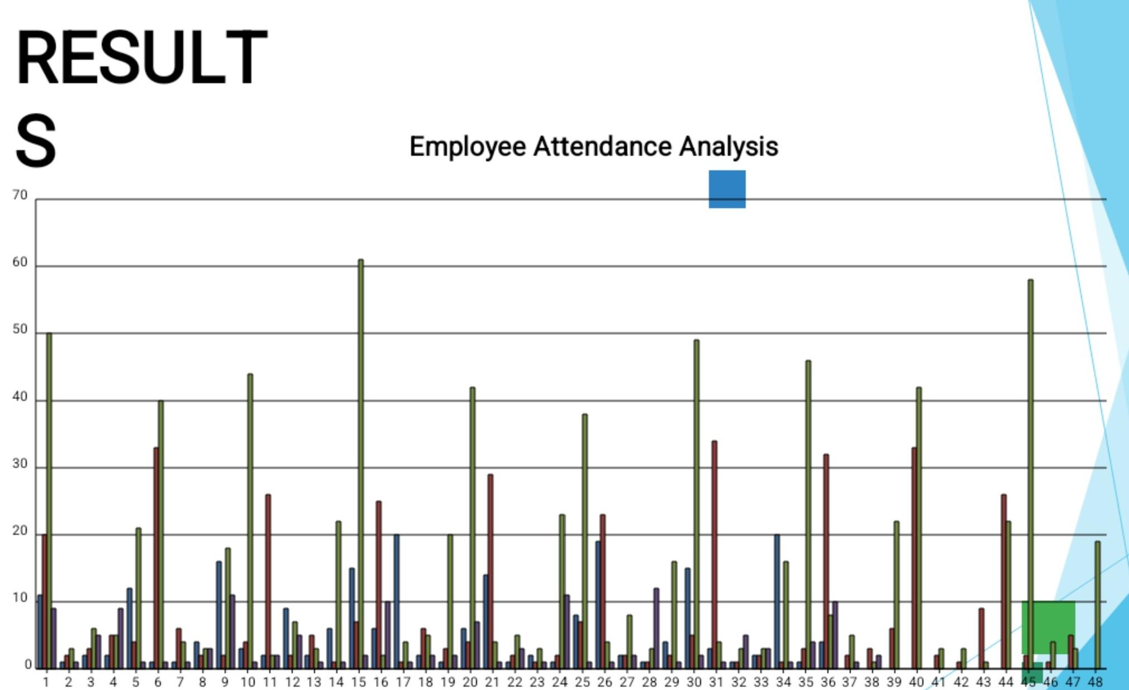
HIGH
LOW
MED
VERY HICH
12

Slide 13

conclusion
The attendance analysis reveals critical insights into employee
patterns and behaviors,highlighting trends,anomalies,and areas for improvement.By examining data on attendance times,absenteeism rates,and punctuality,we can identify key factors impacting
attendance and develop targeted strategies to address issues.Key findings include identifying peak absenteeism periods,correlating
attendance with departmental performance,and pinpointing frequent late arrivals.Implementing recommendations such as flexible
scheduling,improved time management practices,and enhanced communication of attendance policies can significantly enhance overall attendance rates and operational efficiency.This analysis provides a robust foundation for informed decision-making and continuous improvement in attendance management

